Slide 1
Key Challenges for Contemporary HRM
Session 3/10
Part III

Slide 2
What are the key challenges for HRM?
Attracting and managing a diverse workforce

Slide 3
Demographic trends
Ageing workforce
Increasing participation of women in the labour force
Increasing workforce diversity

Slide 4
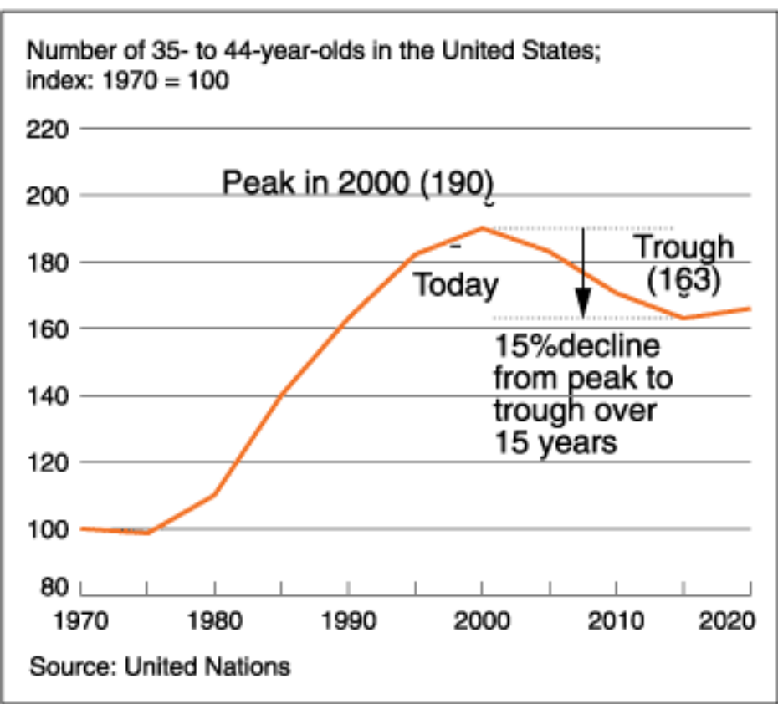
Ageing workforce
In the US the number of workers aged 35–44 years will decline by 15% between 2000 and 2015;
(Source: Chambers et al., 1998)

Slide 5
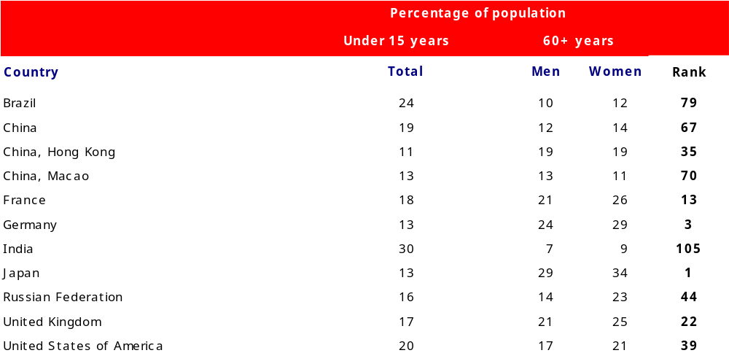
Demographics - Ageing workforce
Source: UN (2012)
201 Countries

Slide 6
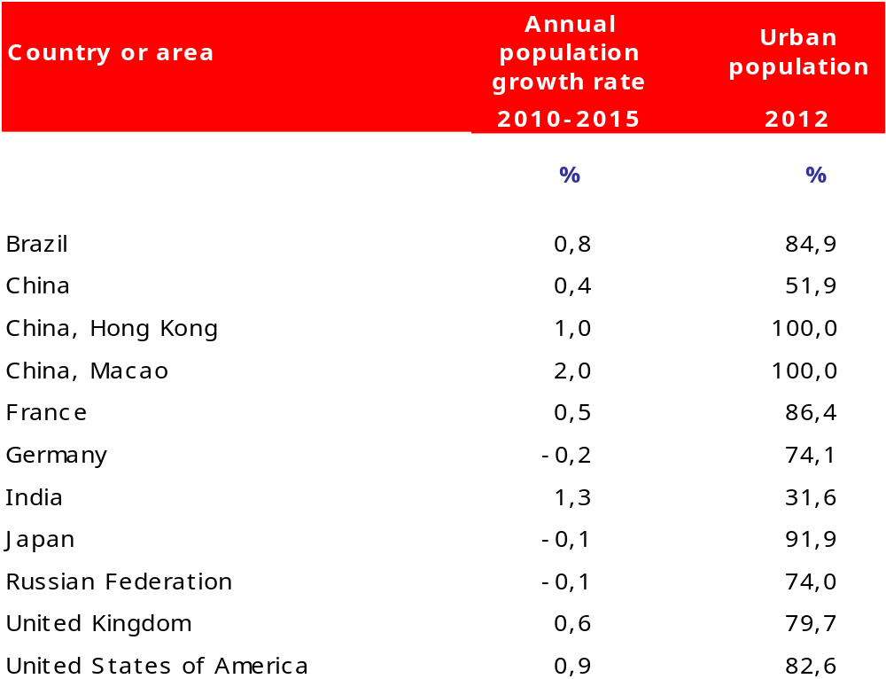
Demographics – Population Growth
Source: UN

Slide 7
Ageing workforce
In most European countries the population is ageing at an accelerated pace;
In Japan, the working population between the ages of 15 and 29 years has declined from 34% to 20% since 1970 as a result of decreasing birth rates;
In India and China the demographics are favourable but these countries still do not produce enough graduates of the caliber required by the large MNCs.

Slide 8
Ageing workforce
  Generational differences in work values
    Older generations (Baby boomers) consider work as a central life interest, whereas the younger generation (Millenials) is more focused in their out of work life;
    Older generations tend to be more committed to their organizations, whereas the younger generations are more committed to their own values and interests (Smola & Sutton, 2002)
Challenges for HRM:
How to devise policies that motivate people with different values, goals and career ambitions?
What roles should older workers take?
How to keep older workers motivated?

Slide 9
Increasing participation of women in the workforce
Labour force participation rate (Women)
 | 1989 | 1991 | 1993 | 1995 | 1997 | 1999 | 2001 | 2003 | 2005 | 2007 | 2009 | 2010 | 2011 | 2012 | 2013
France | 57,4 | 57,9 | 59,4 | 60,2 | 60,4 | 61,6 | 62,1 | 63,9 | 64,6 | 65,2 | 66,5 | 66.4 | 66.5 | 67.1 | 67.5
Germany | 55,1 | 61,0 | 61,4 | 61,5 | 62,5 | 63,5 | 64,4 | 65,1 | 67,6 | 70,2 | 71,3 | 71.8 | 72.8 | 72.9 | 73.7
UK | 67,8 | 68,0 | 67,9 | 67,9 | 68,9 | 69,4 | 69,7 | 70,2 | 70,8 | 71,0 | 71,7 | 71.9 | 72.2 | 72.8 | 73.7
US | 69,5 | 69,6 | 70,3 | 71,6 | 72,5 | 72,6 | 72,4 | 71,9 | 71,6 | 71,7 | 72,0 | 71.4 | 70.9 | 70.9 | 70.7
Source: OECD Employment Statistics Database (own tabulation)

Slide 10
Increasing participation of women in the workforce - Challenges for HRM
Even though the majority of new jobs created over the last decades has been taken by women, they have not abandoned their traditional roles in the household (Allen and Finkelstein, 2014)
Demand for pro-family and employment flexibility policies (flexible hours; part-time work)

Slide 11
Ethnic and cultural diversity
The increasing pace of globalization has favoured intense migration flows to developed countries
The workforce in countries such as the US and the UK is culturally and ethically diverse
Ethnic and cultural diversity is both a source of conflict and a source of competitive advantage

Slide 12
Is diversity associated with performance?
The pessimistic view
More diverse teams experience higher levels of conflict and take longer to arrive at decisions
Why is this the case?
Social identity theory (Mannix et al., 2005) explains that people tend to classify themselves and others in categories (e.g. British vs Non-British) and develop stereotypes about individuals and groups belonging to some categories (e.g. Germans are very organized). People/groups also tend to see themselves in a positive light and develop negative views about other groups.
In more diverse groups people have to overcome stereotypes, define rules and understand how to communicate effectively

Slide 13
Is diversity associated with performance?
The optimistic view
More diverse teams often arrive at more innovative and creative solutions for problems
Diverse teams reflect the social, ethnic and cultural composition of society and should therefore help organizations succeed.
Challenges for HRM:
How to turn ethnic and cultural diversity into a competitive advantage?

Slide 14
References
Allen, T. D., & Finkelstein, L. M. (2014). Work–family conflict among members of full-time dual-earner couples: An examination of family life stage, gender, and age. Journal of occupational health psychology, 19(3), 376.
Arthur, M. B., & Rousseau, D. M. (1996). A career lexicon for the 21st century. The Academy of Management Executive, 10(4), 28-39.
Giddens, A (1990). The Consequences of Modernity. Cambridge: Polity Press.
Mannix, E., & Neale, M. A. (2005). What differences make a difference? The promise and reality of diverse teams in organizations. Psychological science in the public interest, 6(2), 31-55.
Guest, D. (2004). Flexible employment contracts, the psychological contract and employee outcomes: an analysis and review of the evidence. International Journal of Management Reviews, 5(1), 1-19.
Guest, D. E., & Conway, N. (2002). Communicating the psychological contract: an employer perspective. Human resource management journal, 12(2), 22-38.
Rodrigues, R. A., & Guest, D. (2010). Have careers become boundaryless?. Human Relations, 63(8), 1157-1175.
Rodrigues, R., Guest, D., Oliveira, T., & Alfes, K. (2015). Who benefits from independent careers? Employees, organizations, or both?. Journal of Vocational Behavior, 91, 23-34.
Schein, E. (1978). Career Dynamics: Matching Individual and Organizational Needs. Reading, MA: Addison-Wesley.
Smola, K. W., & Sutton, C. D. (2002). Generational differences: Revisiting generational work values for the new millennium. Journal of organizational behavior, 23(SPI), 363-382.

